Slide 1
Freight in Nevada
Nevada Freight Program

Slide 2
Freight in Nevada
State Freight Program Assessment
Established a Freight Advisory Committee (FAC)
Statewide Freight Plan
Continue to use FAC for special projects

Slide 3
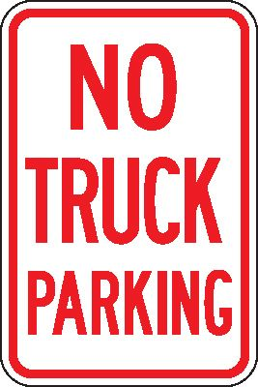
Freight Issues
Freight in Nevada
Freight Issues

Slide 4
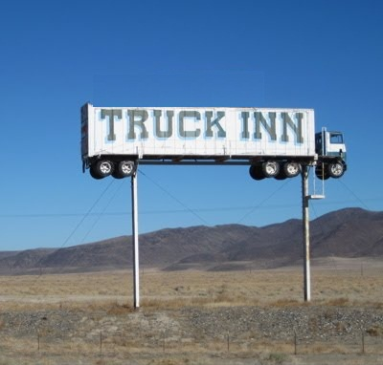
Freight in Nevada
Truck Parking:

Slide 5
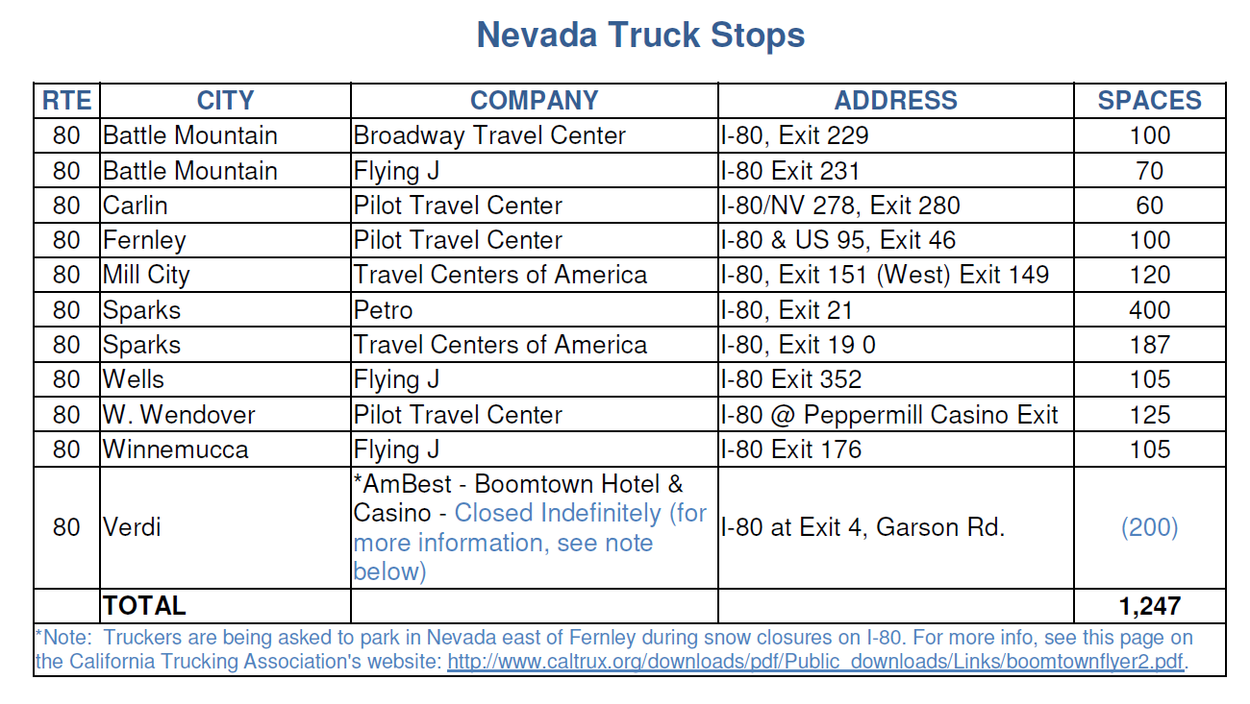
Freight in Nevada
I-80 Truck Parking Facilities
Notes:
Truck Parking Facilities total 1247 spaces.

Slide 6
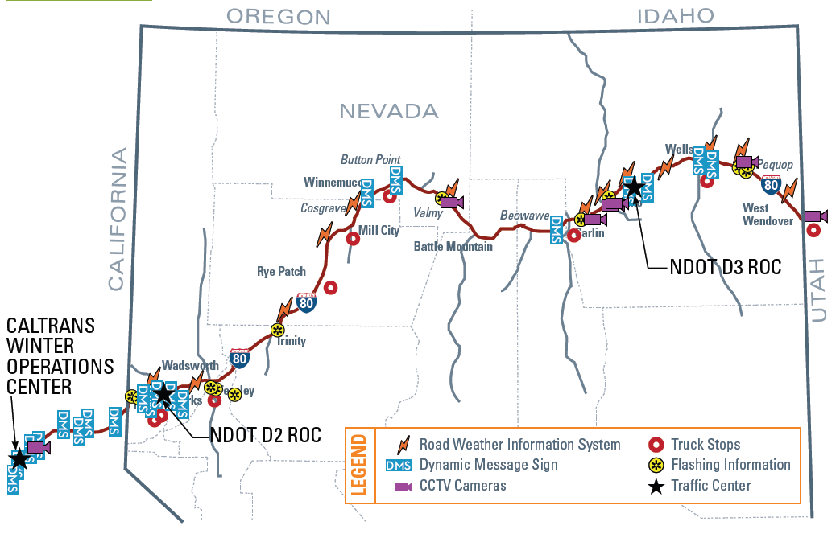
Freight in Nevada

Slide 7
Freight in Nevada
Average Daily Truck Traffic (ADTT)
Route | From | TO | LT2AX |  | LT3AX | HT4AX | HT5AX | HT6AX | AADTT
IR80 | CA / NV Stateline | Robb Dr. | 1995 |  | 170 | 210 | 3450 | 330 | 6155
IR80 | Robb Dr. | Keystone Ave |  | 1135 | 185 | 200 | 3900 | 310 | 5730
IR80 | Keystone Ave | Wells Ave |  | 1315 | 550 | 230 | 5200 | 450 | 7745
IR80 | Wells Ave | US395 |  | 975 | 225 | 235 | 3755 | 155 | 5345
IR80 | US395 | Sparks Blvd |  | 605 | 520 | 350 | 3810 | 400 | 5685
IR80 | Sparks Blvd. | Mustang |  | 400 | 280 | 325 | 4050 | 650 | 5705
IR80 | USA Parkway | E. Fernley |  | 180 | 140 | 295 | 4340 | 890 | 5845
IR80 | E. Fernley | US95 (Trinity) |  | 45 | 30 | 105 | 2715 | 435 | 3330
IR80/US95 | US95 (Trinity) | W. Winnemucca |  | 100 | 25 | 75 | 2750 | 430 | 3380
IR80/US95 | W. Winnemucca | Winnemucca Blvd. E. |  | 150 | 25 | 55 | 2575 | 425 | 3230
IR80 | Winnemucca Blvd. E. | Elko West |  | 80 | 60 | 95 | 2150 | 405 | 2790
IR80 | SR304 | SR305 |  | 165 | 25 | 90 | 2700 | 515 | 3495
IR80 | Elko West | Osino |  | 275 | 25 | 115 | 1950 | 345 | 2710
IR80 | Osino | E. Wells / US93 |  | 50 | 55 | 70 | 1900 | 310 | 2385
IR80 | E. Wells | NV / UT Stateline |  | 413 | 35 | 160 | 1580 | 280 | 2468

Slide 8
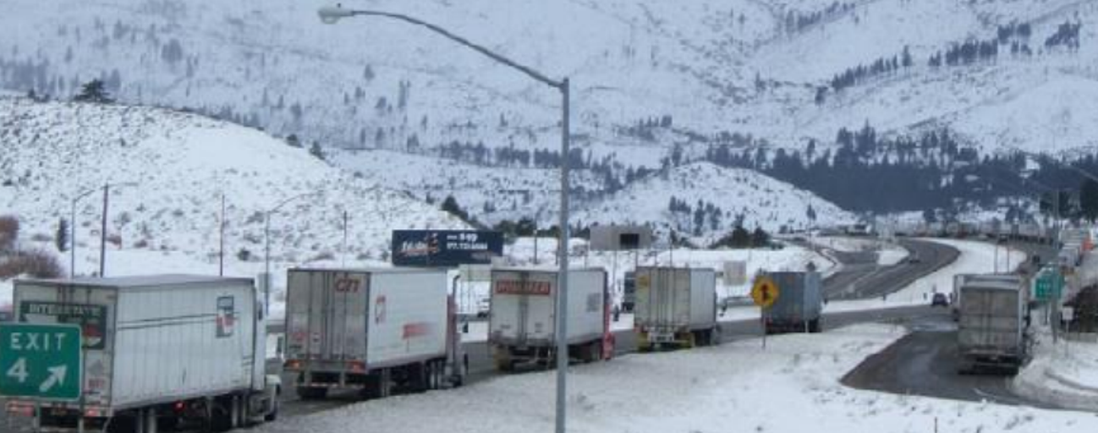
Freight in Nevada

Slide 9
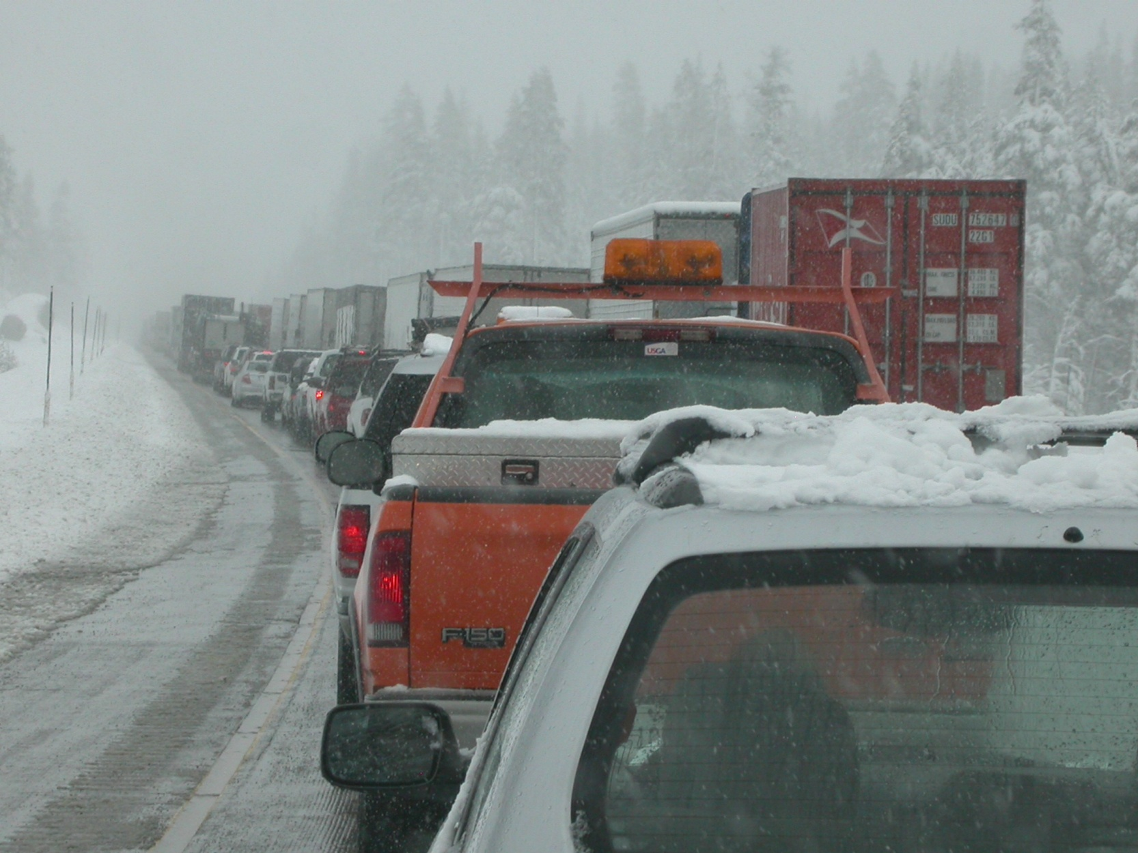
Freight in Nevada

Slide 10
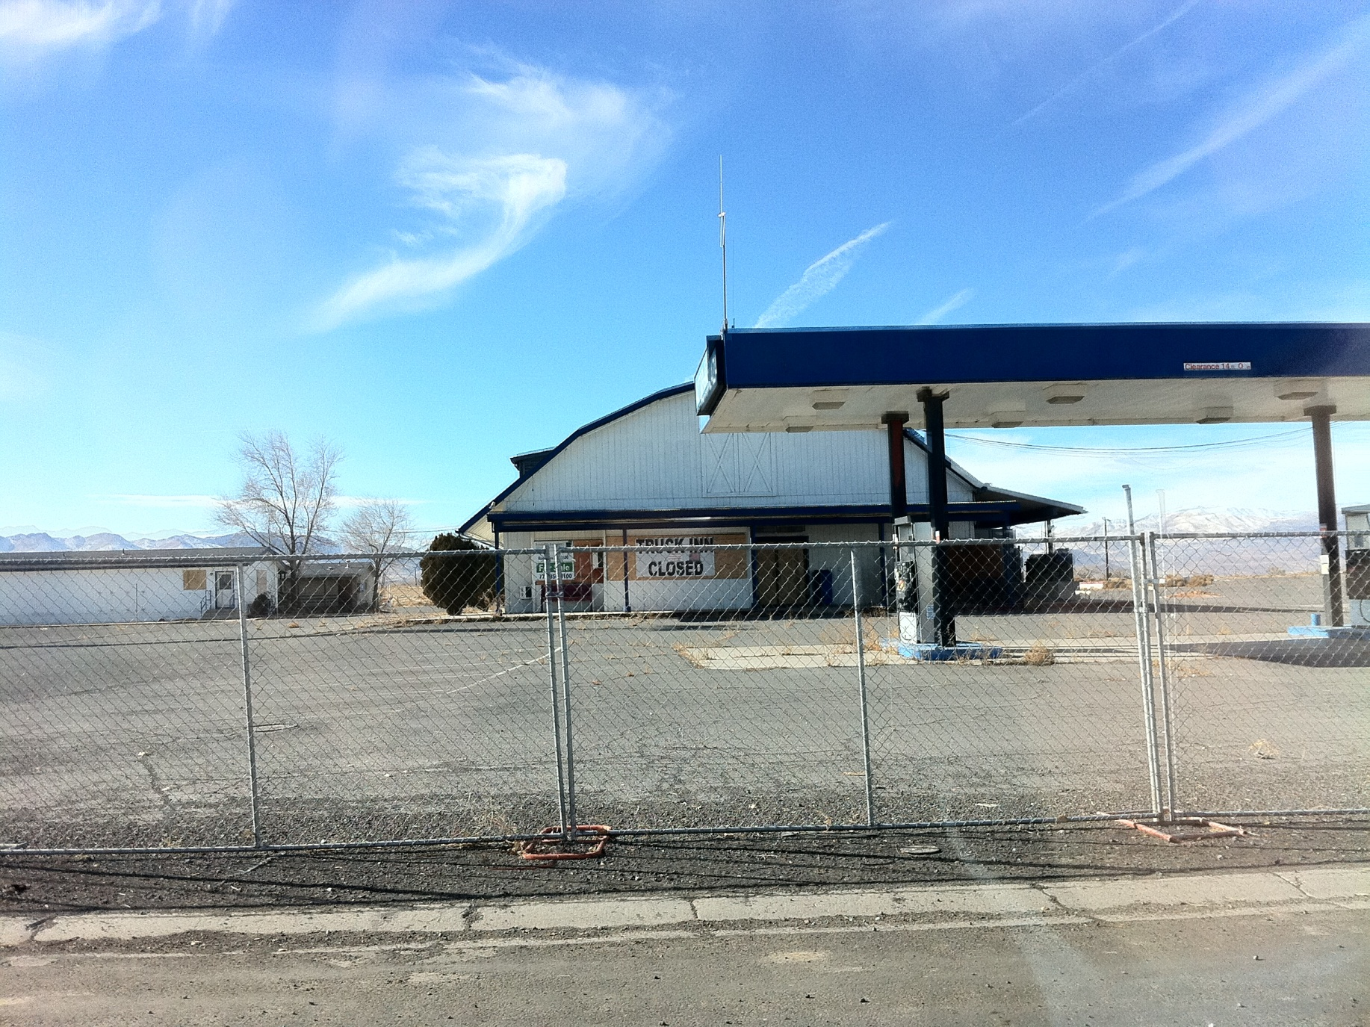
Freight in Nevada
Notes:
NDOT DII and Planning have been looking at the Truck Inn located in the Fernley for possible truck parking for emergency events.

Slide 11
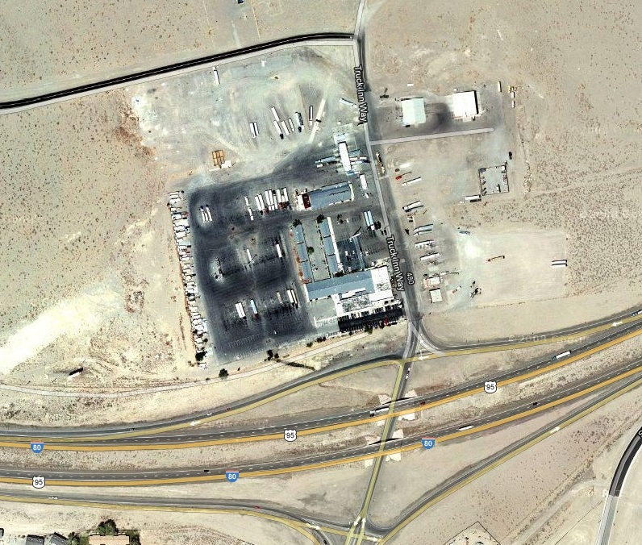
Freight in Nevada
Notes:
Aerial of the property

Slide 12
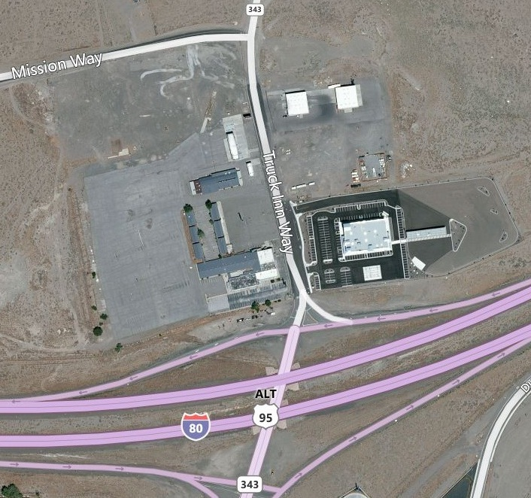
Freight in Nevada
Notes:
Aerial of the property

Slide 13
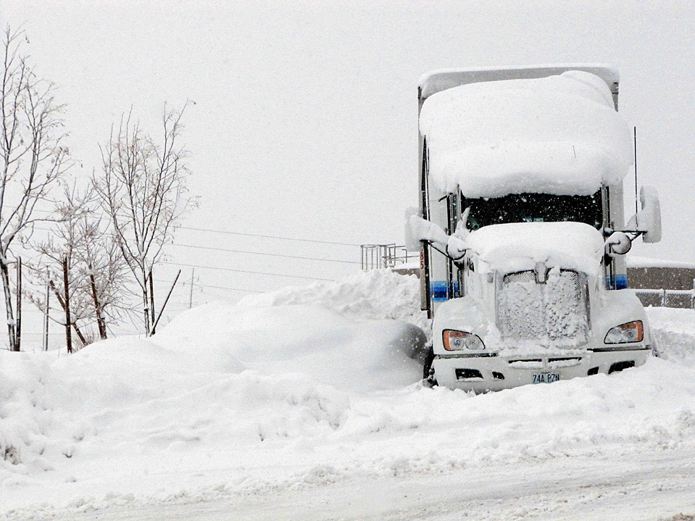
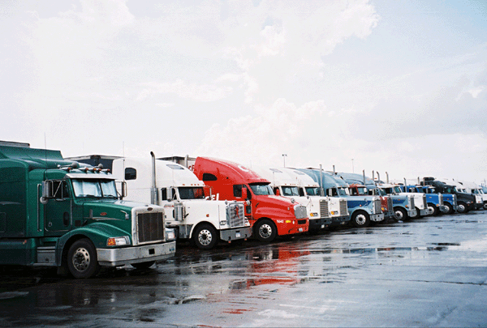
Freight in Nevada
ISSUES
Require some improvements
Require maintenance
Funding

Slide 14
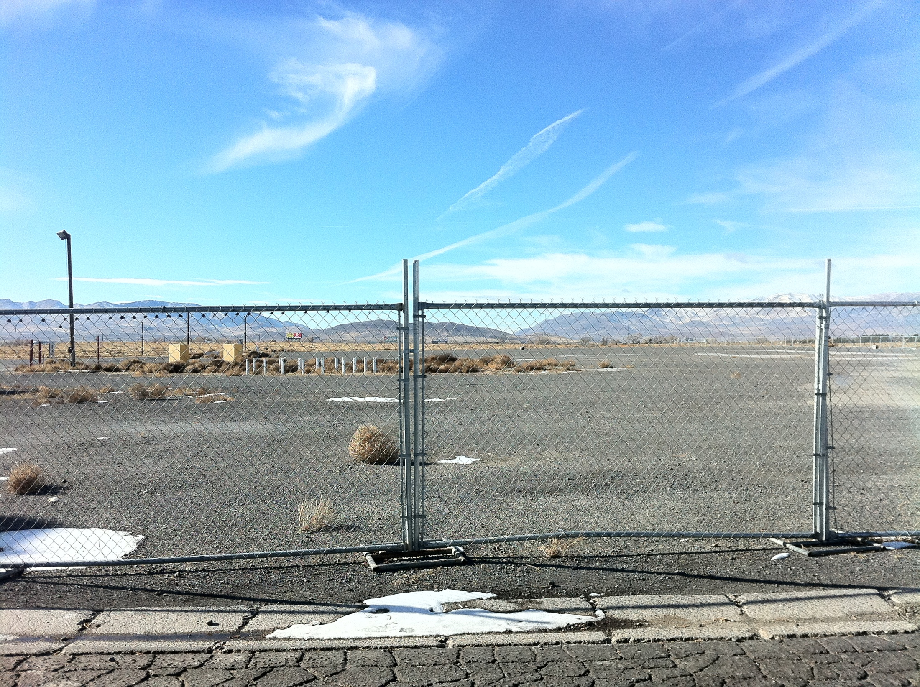
Freight in Nevada
Notes:
This is a look from the outside before any improvements.

Slide 15
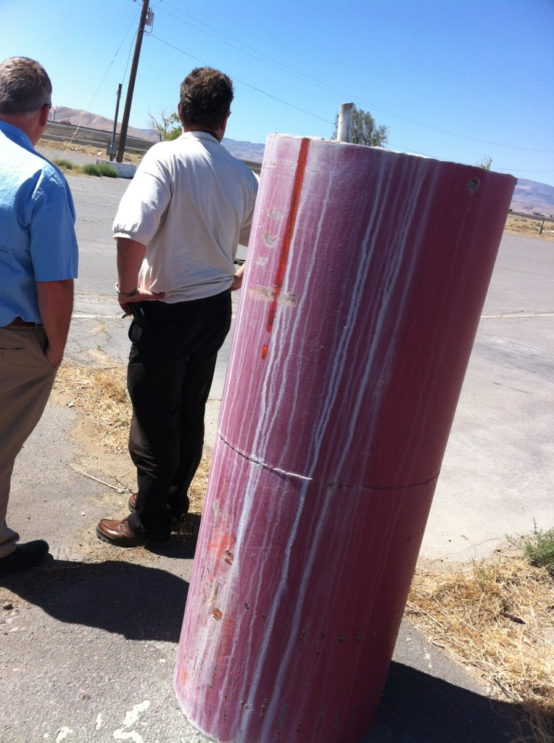
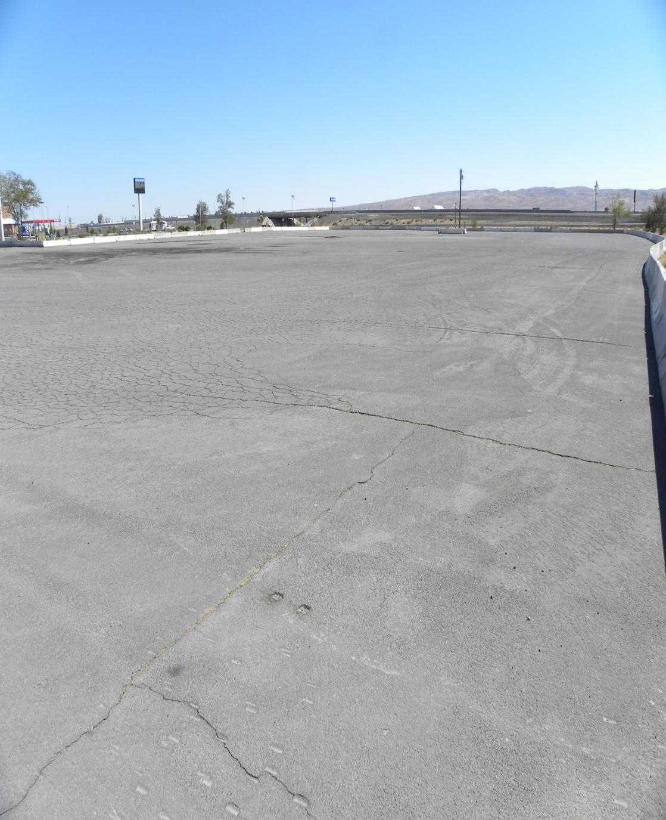
Freight in Nevada

Slide 16
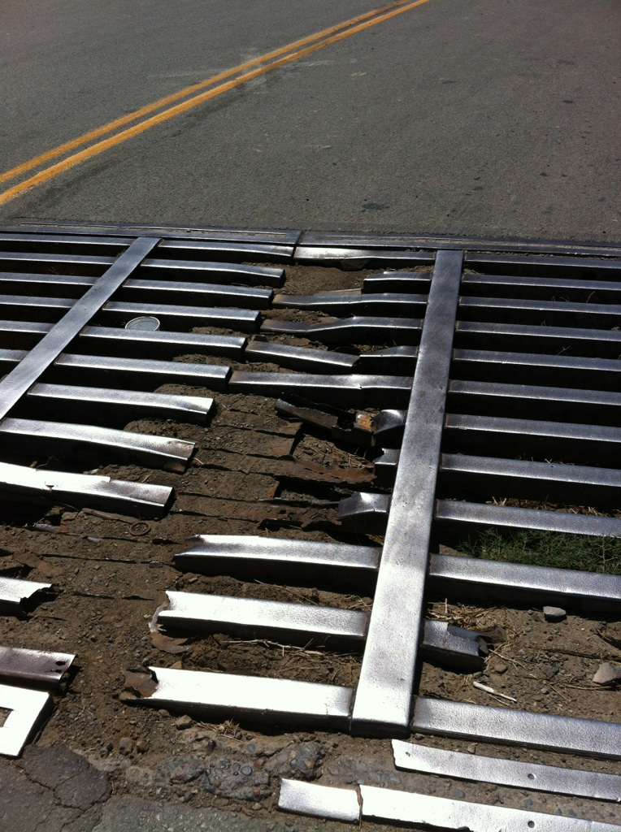
Freight in Nevada

Slide 17
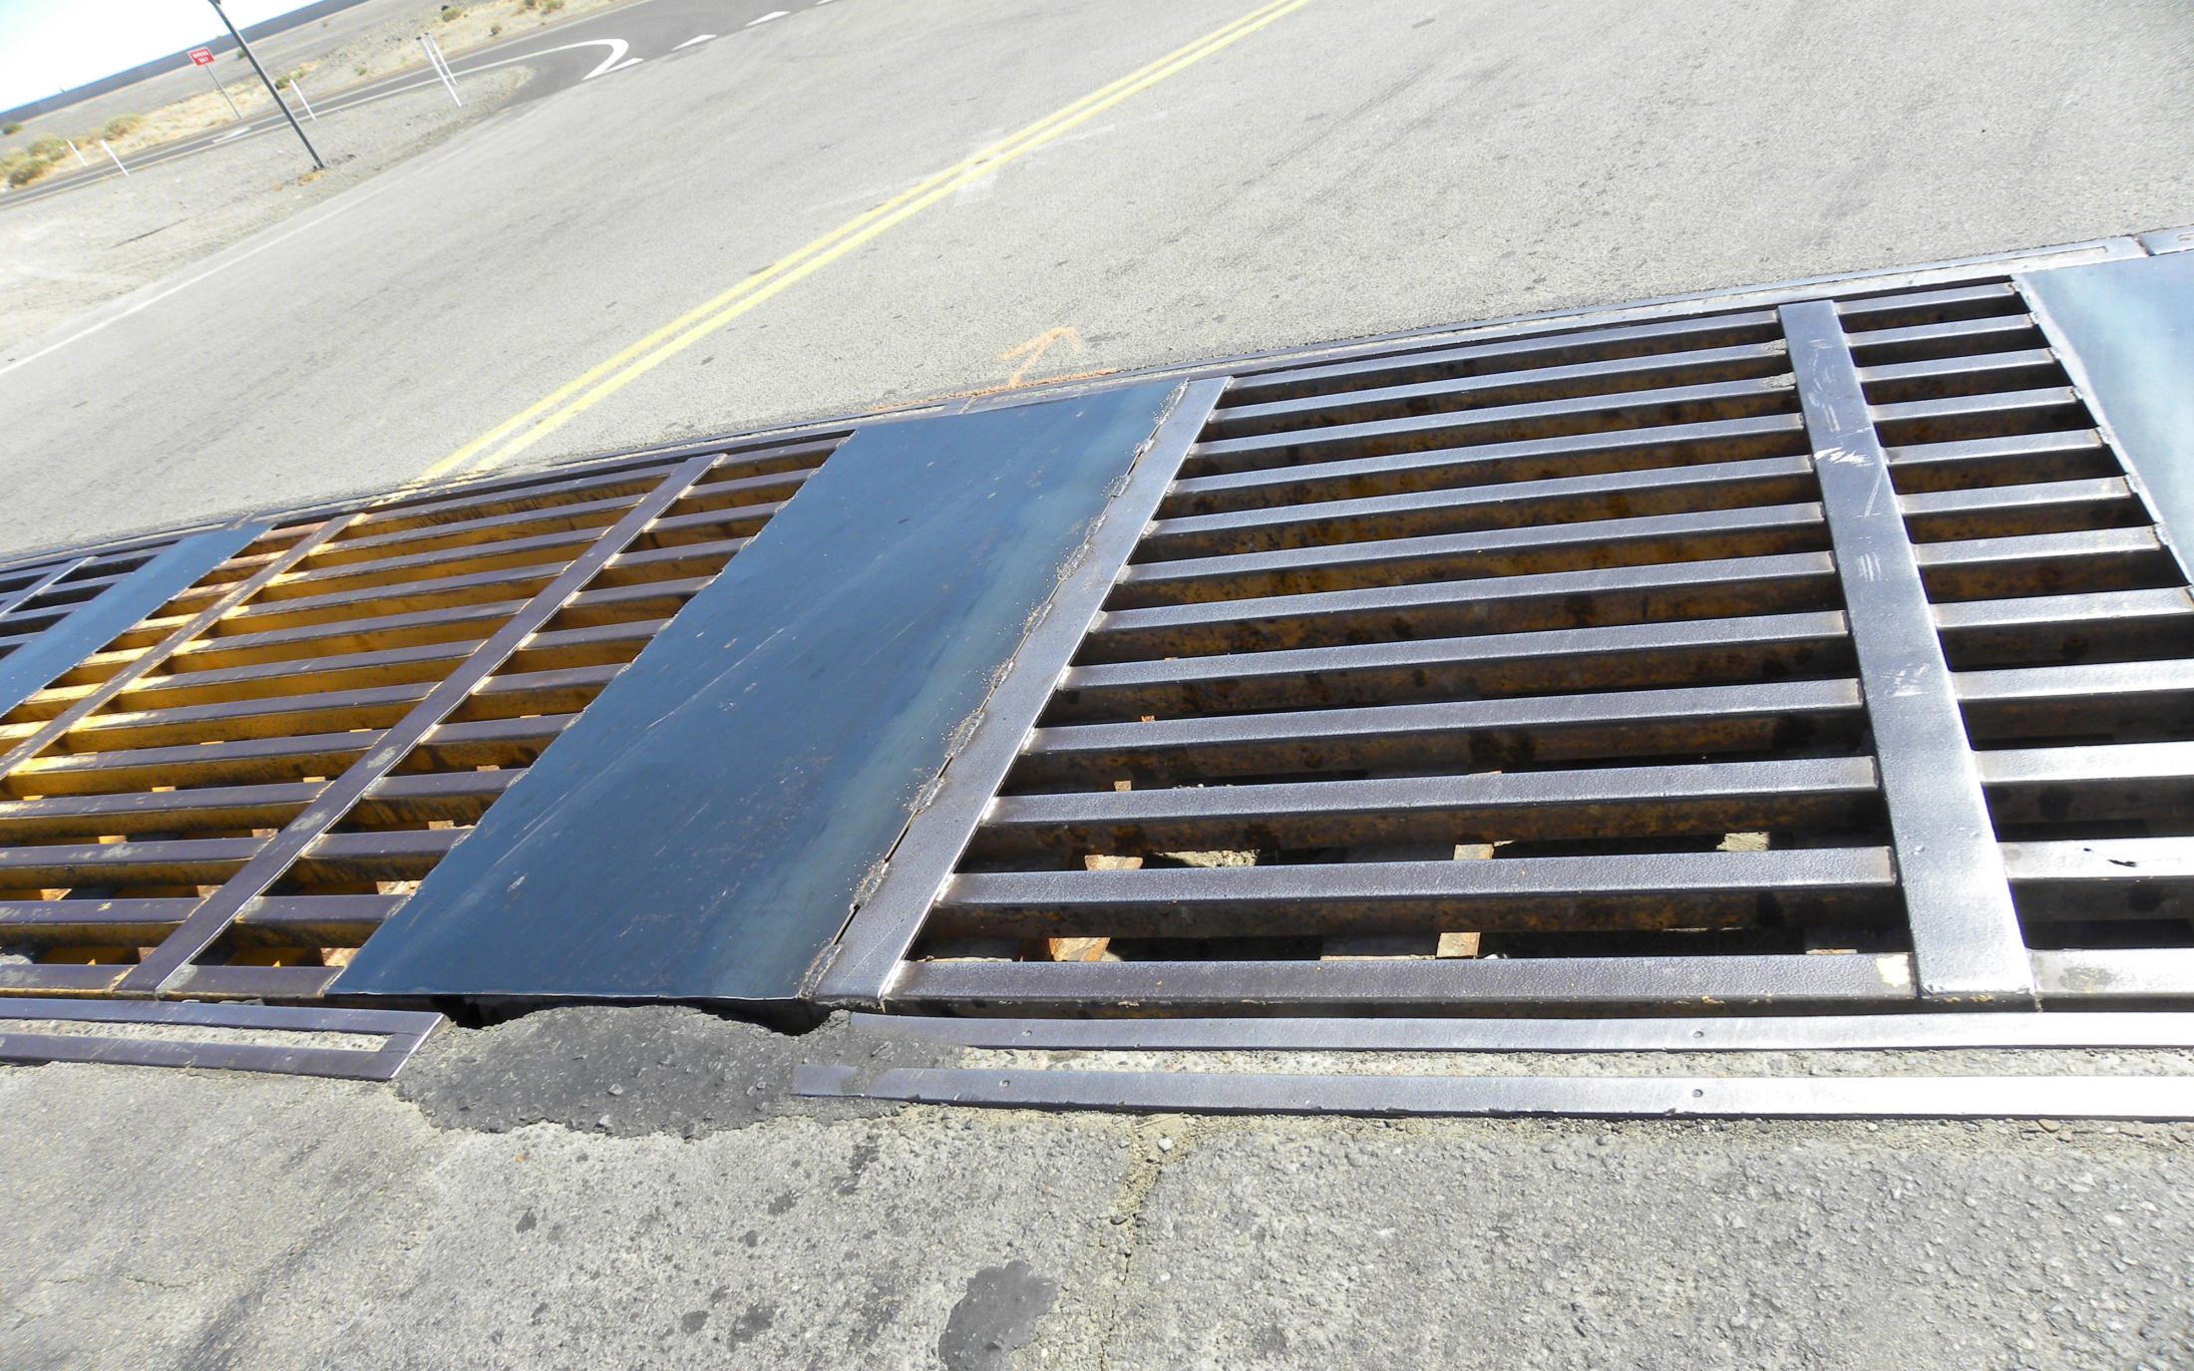
Freight in Nevada

Slide 18
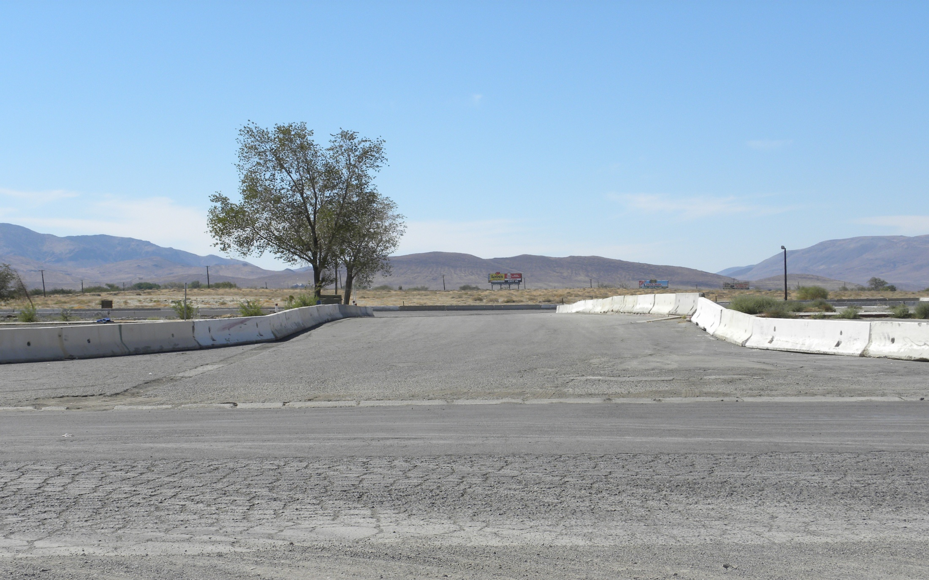
Freight in Nevada

Slide 19
Freight in Nevada
Notes:
waiting for striping for 82 truck parking spaces

Slide 20
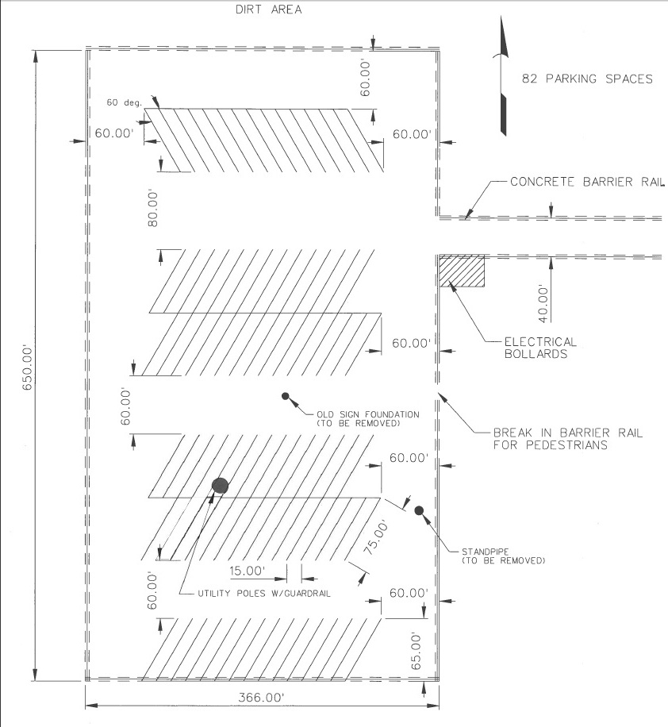
Freight in Nevada

Slide 21
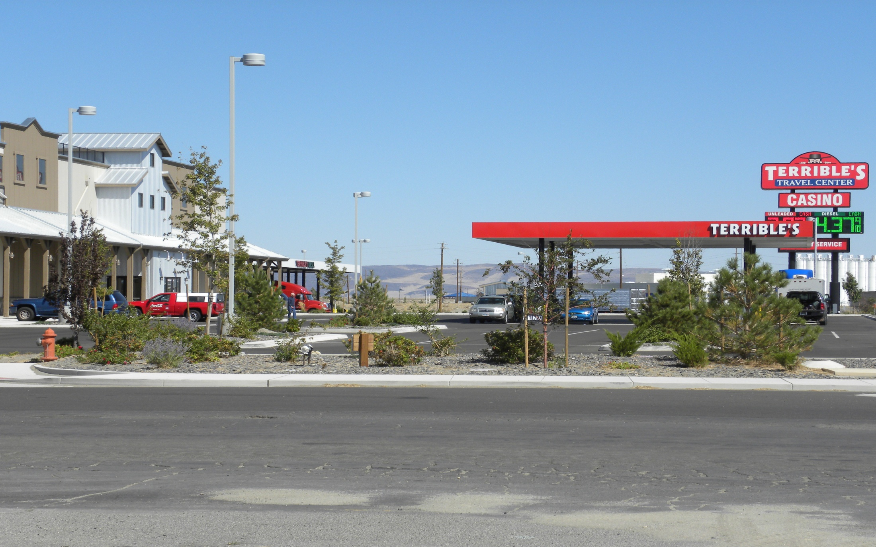
Freight in Nevada

Slide 22
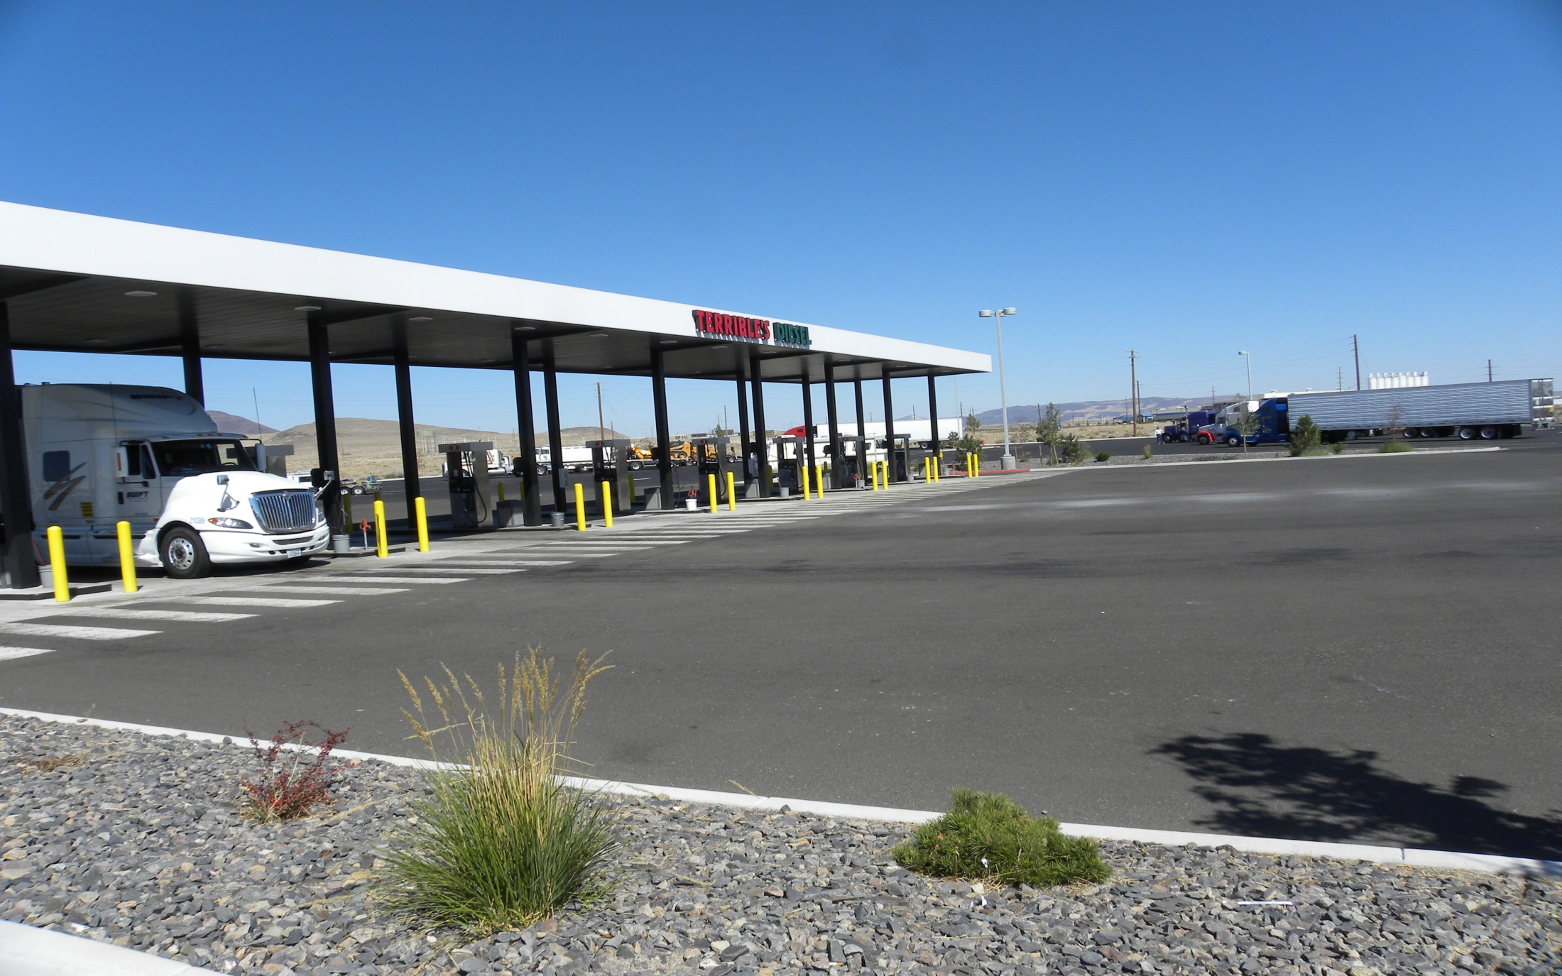
Freight in Nevada

Slide 23
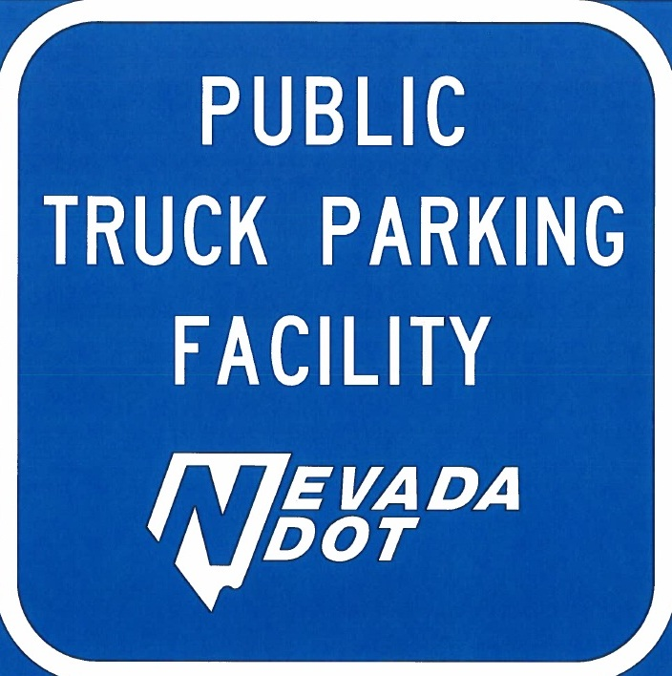
Freight in Nevada

Slide 24
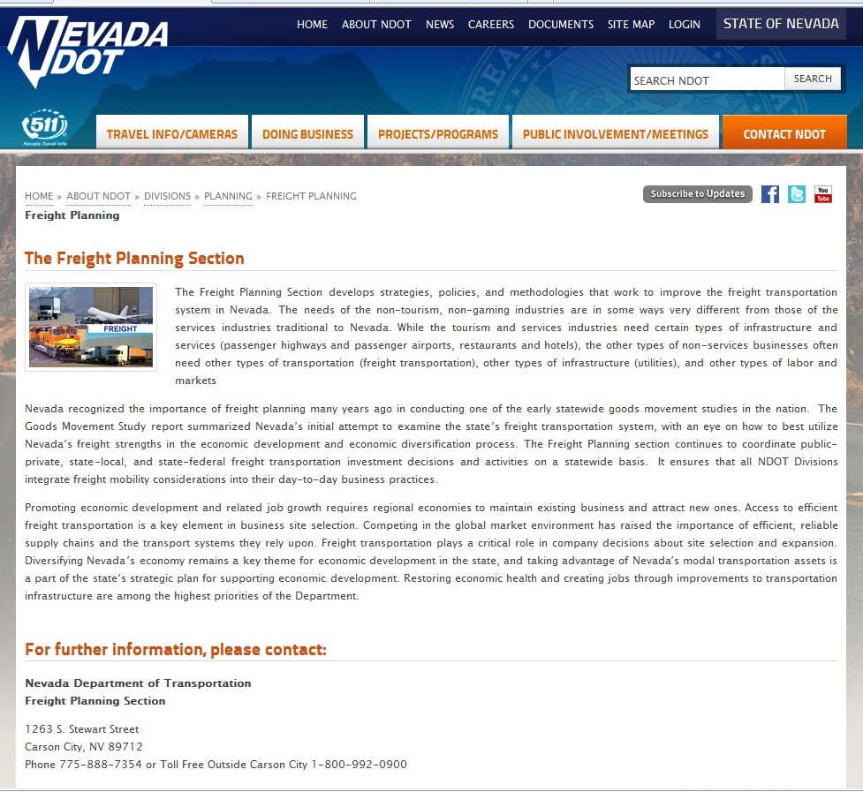
Freight in Nevada
Freight Website
Notes:
Other activities:

Slide 25
Freight in Nevada

Slide 26
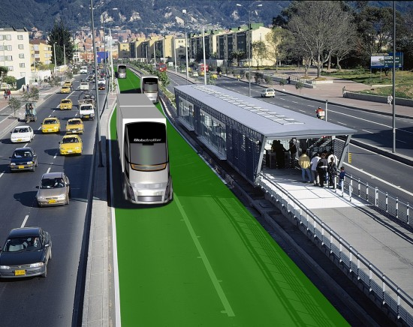
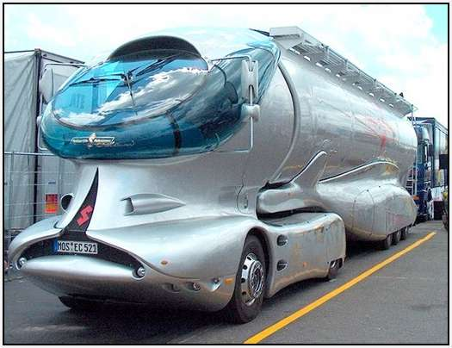
Freight in Nevada
Questions
Notes:
Questions

Slide 27
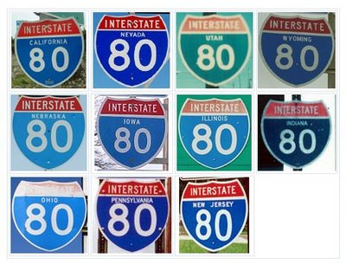
Freight in Nevada
Contact Information:
Freight@dot.state.nv.us
Eric Glick
Aviation/Freight/Rail Program Manager
eglick@dot.state.nv.us
775-888-7464
Bill Thompson
Freight Planning Coordinator
bthompson@dot.state.nv.us
775-888-7354
http://www.nevadadot.com/About_NDOT/NDOT_Divisions/Planning/Freight/Freight_Planning.aspx

